Slide 1

APSSDC AWS PROJECT Batch - 2

Slide 2
Title of the Project
Serverless Web Application using AWS Services
Project Members:
M. Lakshmi Devi
M. Sirisha
C. Seenu

Slide 3
Introduction:
In the contemporary digital era, web applications form the backbone of many business operations, providing platforms for interaction, data management, and service delivery. Traditional server-based architectures, however, often face challenges such as scalability, maintenance overhead, and cost efficiency. To address these issues, serverless architecture has emerged as a revolutionary approach, offering scalable and maintenance-free solutions. This project, titled "Serverless Web Application on AWS," demonstrates the creation of a robust, serverless web application that leverages the power of AWS services to deliver a seamless user experience while minimizing operational complexities.
The core objective of this project is to build a fully functional web application that allows users to perform Create, Read, Update, and Delete (CRUD) operations on a dataset stored in AWS DynamoDB. By employing AWS Lambda for backend processing, Amazon S3 for static file hosting, and CloudFront for content delivery, this project exemplifies how to integrate various AWS services into a cohesive, efficient, and scalable application.

Slide 4
AWS Services Used:
1) Amazon S3
2) CloudFront
3) Route53
4) DynamoDB
5) AWS Lambda
6) IAM

Slide 5
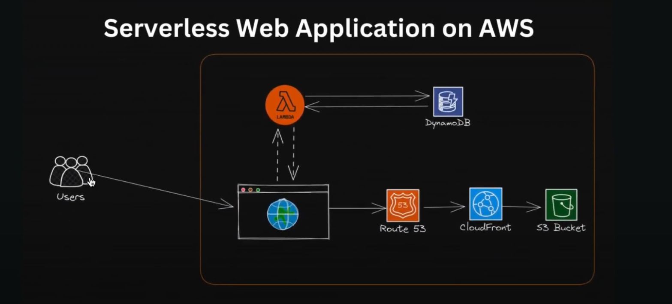
Architecture:

Slide 6
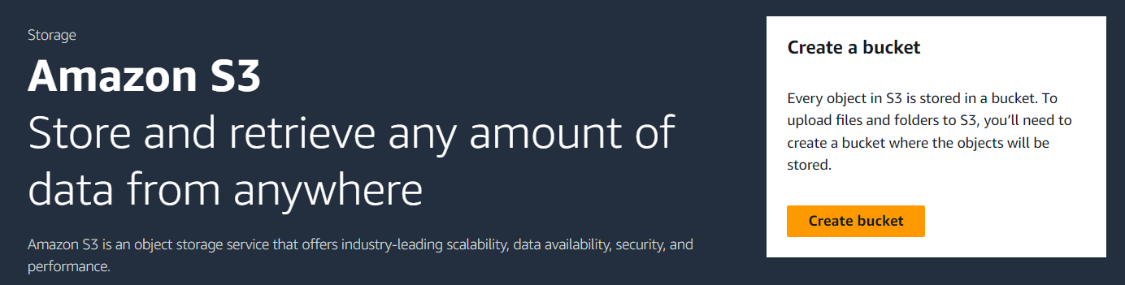
Step-1: Set up AWS S3 Bucket
Create and upload files(HTML, CSS, JS etc…) into S3 bucket.
Benefits: Provides durable storage, high availability, and scalable storage capacity. It also integrates with other AWS services and offers cost-effective storage options.

Slide 7
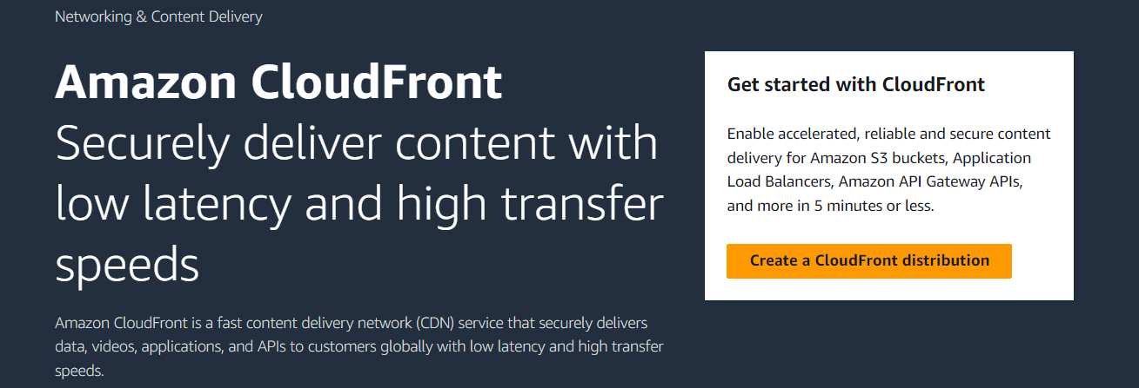
Step-2: Set up AWS CloudFront
Functionality: It caches the static files stored in S3 at edge locations around the world, ensuring faster delivery to users.
Benefits: Enhances the performance of the web application by reducing latency and improving load times.
It also provides security features such as DDoS protection and encryption.

Slide 8
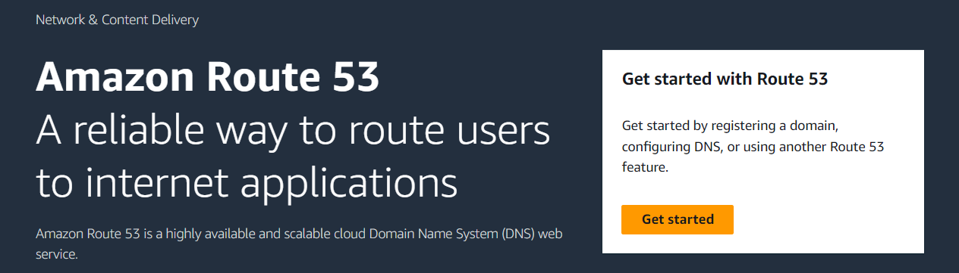
Step-3: Set up AWS Route53
Create Hosted Zone(Domain Name Creation).
Edit Alternate Domain Name in CloudFront.
Custom SSL Certificate for application security.
Validate and Verify SSL certificate.

Slide 9
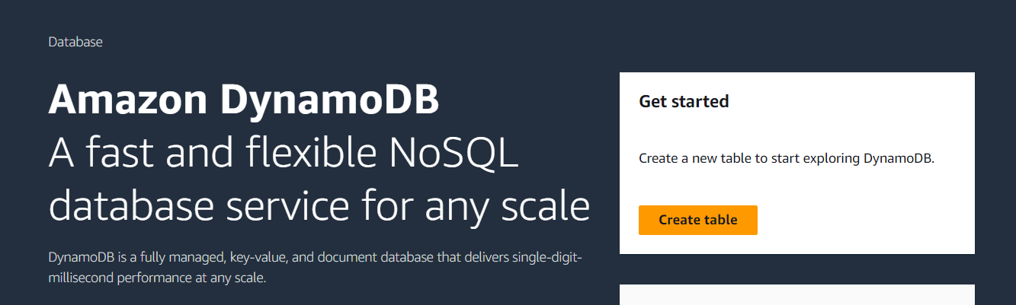
Step-4: Set up AWS DynamoDB
Functionality: It is ideal for storing and querying large amounts of data with low latency and high throughput.
Benefits: Offers built-in high availability and fault tolerance, scales to handle high traffic, and supports flexible data models (key-value and document).

Slide 10
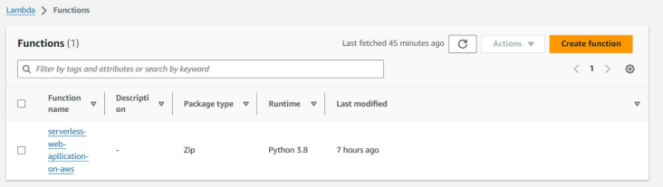
Step-5: Set up AWS Lambda
Purpose: AWS Lambda is a serverless compute service that allows you to run code without provisioning or managing servers.
Functionality: It automatically scales your application by running code in response to each trigger, such as an HTTP request via API Gateway.

Slide 11
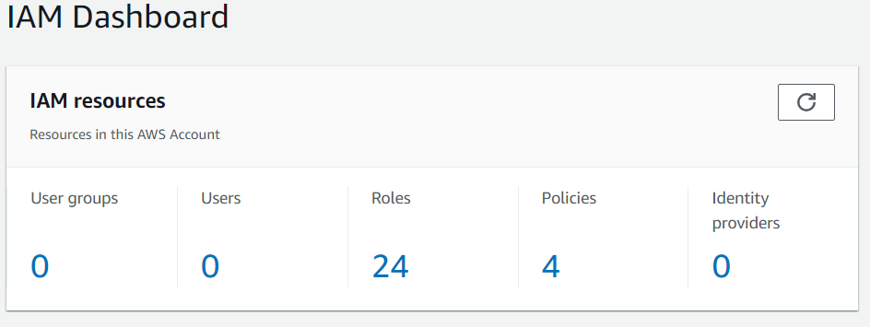
Step-6: Set up AWS IAM
AWS Identity and Access Management (IAM) is a web service that helps you securely control access to AWS resources. With IAM, you can manage permissions that control which AWS resources users can access. You use IAM to control who is authenticated (signed in) and authorized (has permissions) to use resources. IAM provides the infrastructure necessary to control authentication and authorization for your AWS accounts.

Slide 12
Use Case in Real Life Scenario:
Online Learning Platform: Edu-Learn uses AWS Lambda for student management and Amazon S3 for
storing course content.
E-Commerce Website: Shop-Easy uses AWS Lambda for order processing and Amazon S3 for storing
product images.
Event Management System: Eventify uses AWS Lambda for event registrations and Amazon S3 for
storing event materials.
Real-Time Data Processing: DataStream uses AWS Lambda for data analysis and Amazon S3 for
storing historical data.
Social Media Application: ConnectMe uses AWS Lambda for user interactions and Amazon S3 for storing
user profiles.
Customer Support Portal: HelpDesk uses AWS Lambda for ticket management and Amazon S3 for storing
help articles.

Slide 13
Conclusion:
The serverless web application project underscores the advantages of adopting a serverless architecture using AWS services. By eliminating the need for traditional server management, the project demonstrates significant improvements in scalability, cost efficiency, and operational simplicity. AWS Lambda and DynamoDB streamline backend processes, while S3 and CloudFront ensure fast and reliable content delivery. The integration of Route 53 with a custom domain and SSL/TLS certificates enhances the application's security and accessibility.
Throughout the development and testing phases, the project highlighted the importance of proper configuration and integration of AWS services. The successful deployment of this application not only fulfills the project's objectives but also equips developers with practical insights into leveraging serverless technologies.
This experience reinforces the value of AWS's robust ecosystem, offering scalable and secure solutions for modern web applications. Future projects can build on this foundation, exploring further innovations in serverless computing and cloud-based architectures. The project thus serves as a testament to the potential of AWS services in delivering efficient and reliable serverless applications.

Slide 14
Outcome:
The "Serverless Web Application" project successfully demonstrates the benefits of using AWS's serverless architecture. By leveraging AWS Lambda, the application efficiently handles backend logic without the need for server management. The project achieves high availability, automatic scaling, and cost efficiency, making it a powerful example of modern web application development using serverless technologies. Overall, the application is scalable, easy to maintain, and cost-effective, highlighting the advantages of serverless architecture in real-world scenarios.

Slide 15
Reference:
AWS : https://docs.aws.amazon.com
Google : www.google.com

Slide 16


